Slide 1
Laila Hussain Alqawain
Data Foundations Nanodegree
SQL Project
Query a Digital Music Store Database

Slide 2
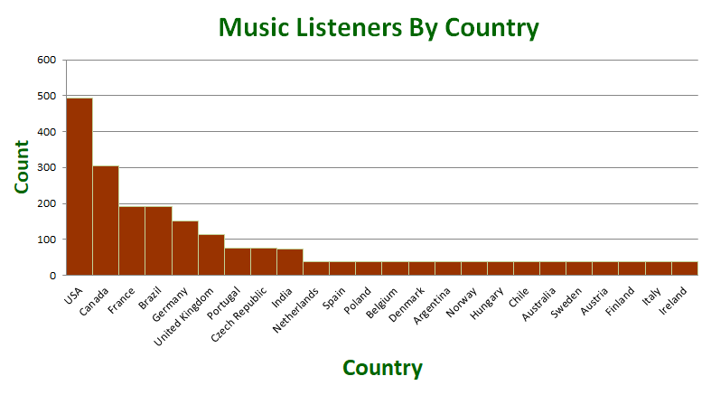
All Music Listeners By Country
<visualization>
As we see, the most of music listeners are from USA. After that Canada. Otherwise are from remaining countries.

Slide 3
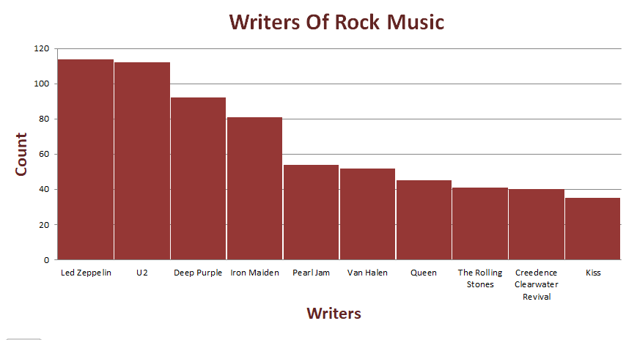
Writers Of Rock Music
<visualization>
Based on dataset, the most customers like Rock Music. Also, Rock Music had written by the most of artists.
As we see, the artist who has written the most Rock Music is Led Zeppelin. He wrote about 114 music. After that is U2 and Deep Purple, and so on.

Slide 4
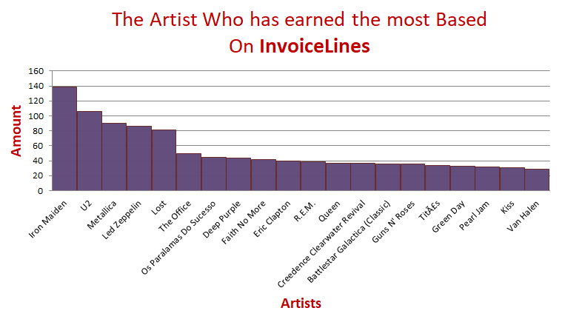
The Artist Who has earned the most Based On InvoiceLines
<visualization>
As we see, the Artist Who has earned the most Based On InvoiceLines is Iron Maiden.
He earned about 138.6.

Slide 5
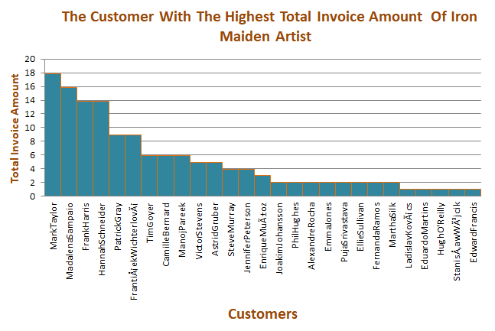
The Customer With The Highest Total Invoice Amount Of Iron Maiden Artist
<visualization>
As we see, the customer with the highest total Invoice amount of Iron Maiden Artist is Mark Taylor.
His total invoice amount is 17.82.

